Slide 1

Spatial mapping in R
Shade Wilson
Jamal Yearwood
16/8/19

Slide 2


Who we are
Shade Wilson
Post-Bachelor Fellow
Skin Diseases, Causes of Death
Jamal Yearwood
Post-Bachelor Fellow
Heath Access and Equality Index (HAQI), Health Systems

Slide 3
Introductions
This is a workshop, not a lecture! We want to know more about you
Name
Your work at INSP
Experience using R
Experience in Stata, other programming languages

Slide 4
About this training
Aim to talk ~15 mins per section
Majority of time on exercises
Goals:
R basics
Spatial mapping
Feel free to stop and ask questions

Slide 5
Outline
Intro to R
R basics
Vectors
Data frames
Introduction to spatial data in R
Manipulating spatial data
If time permits:
R vs Stata (?)
Spatial data in R using ggplot2 and leaflet

Slide 6
Intro to R

Slide 7
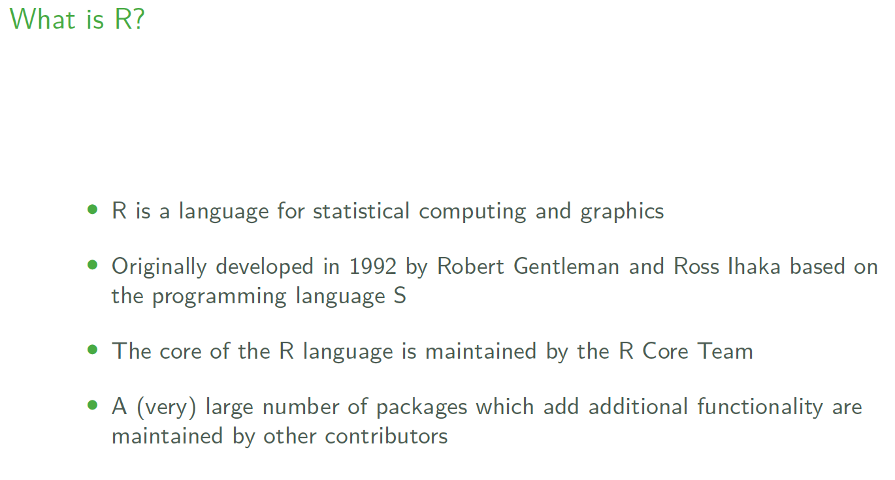

Slide 8
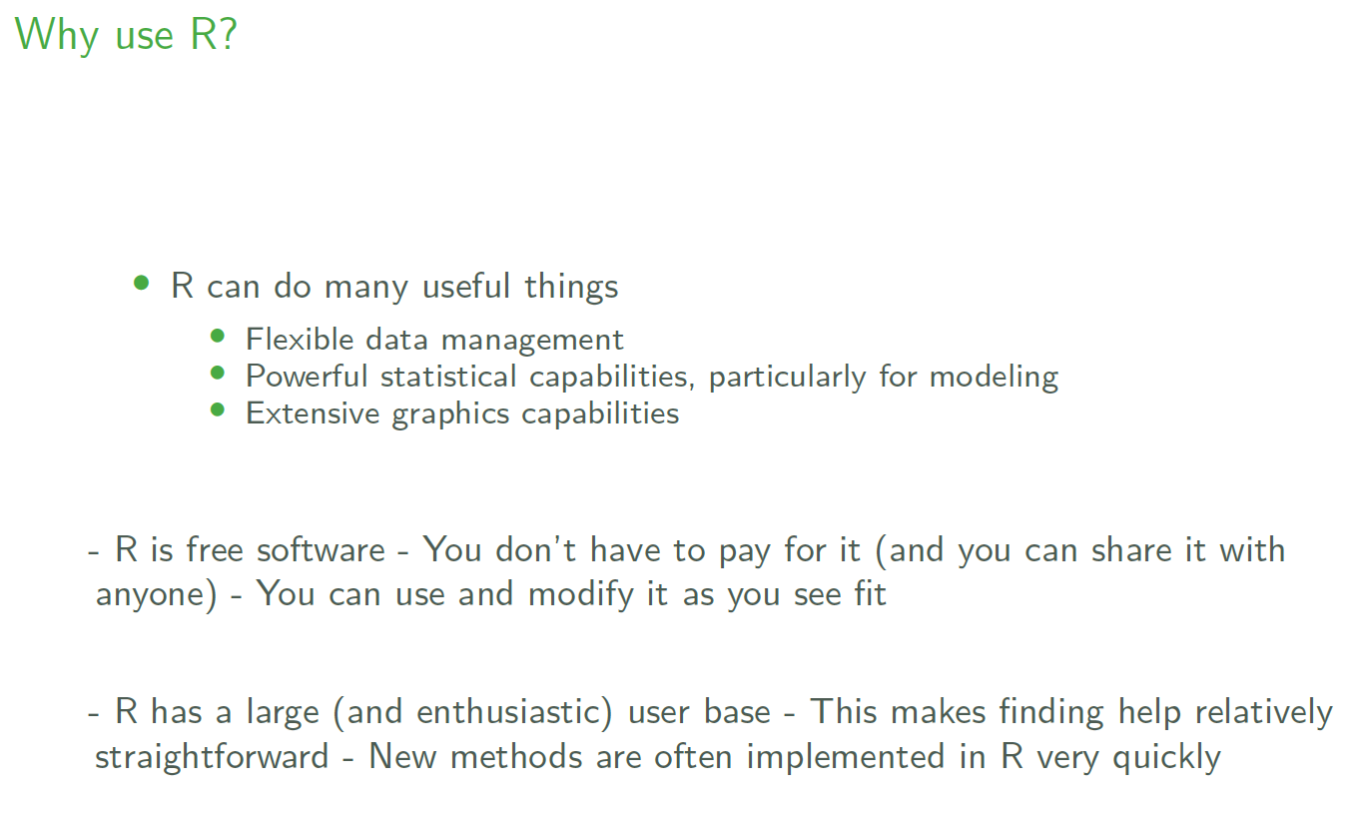

Slide 9
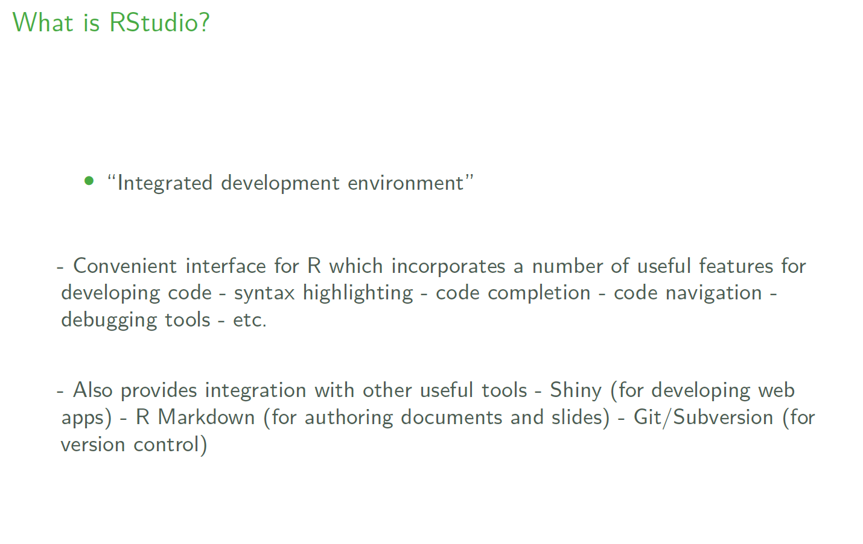

Slide 10
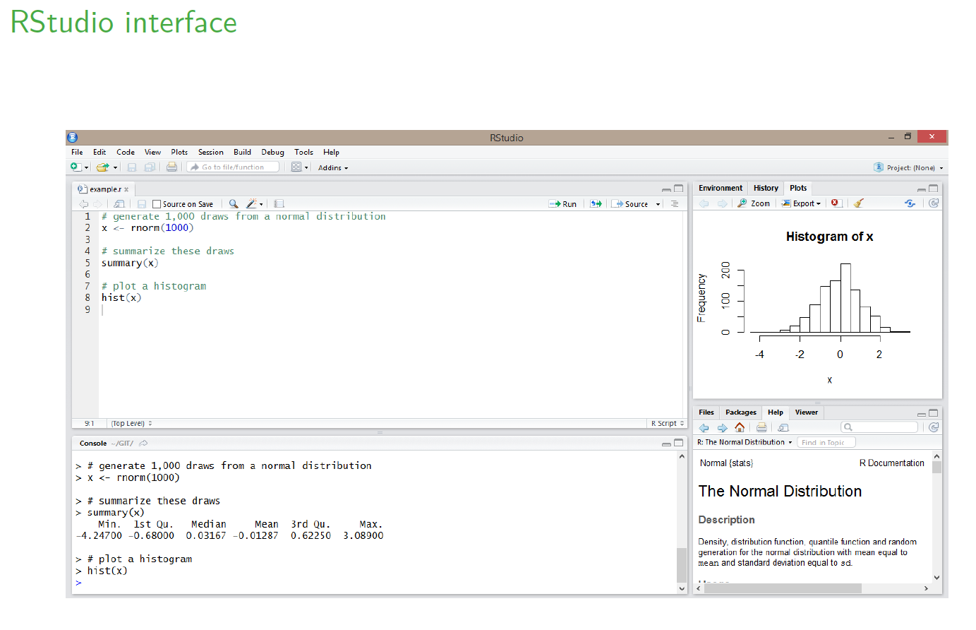

Slide 11
R Basics

Slide 12
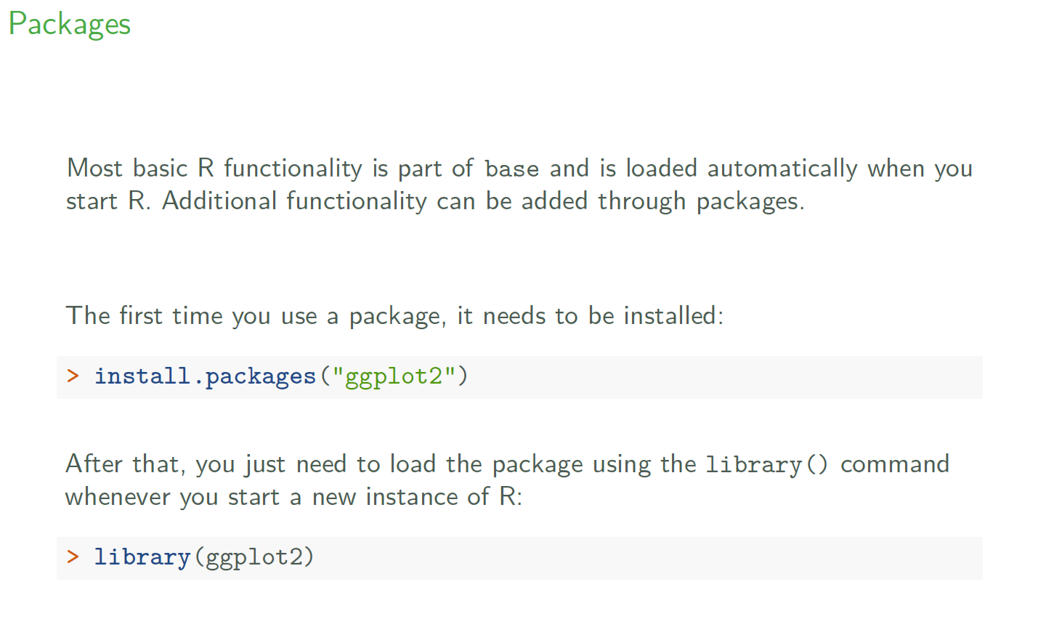

Slide 13
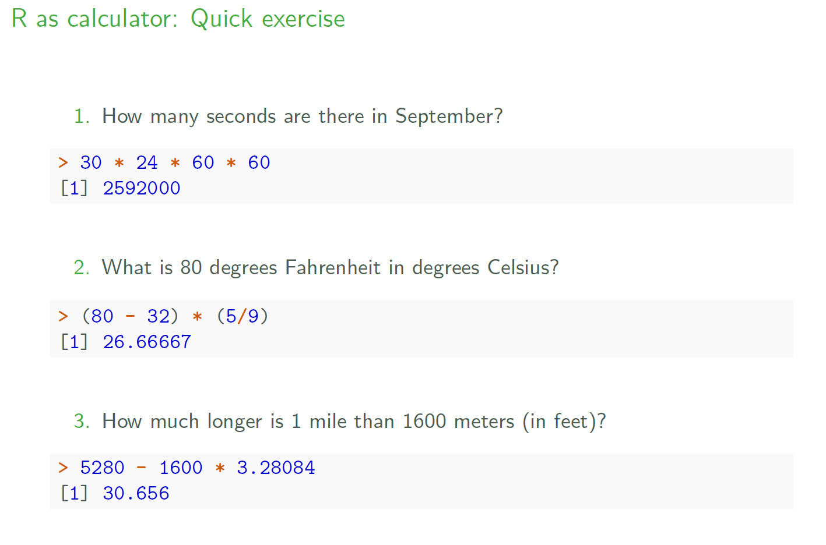

Slide 14
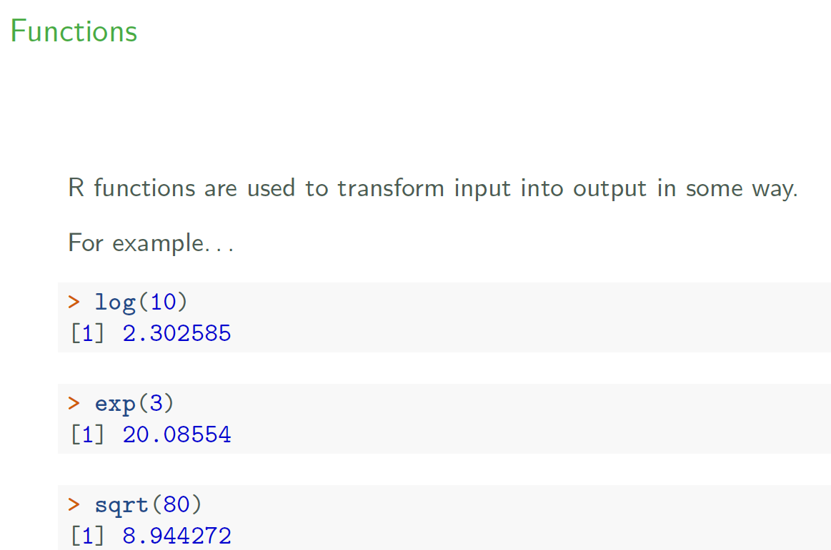

Slide 15
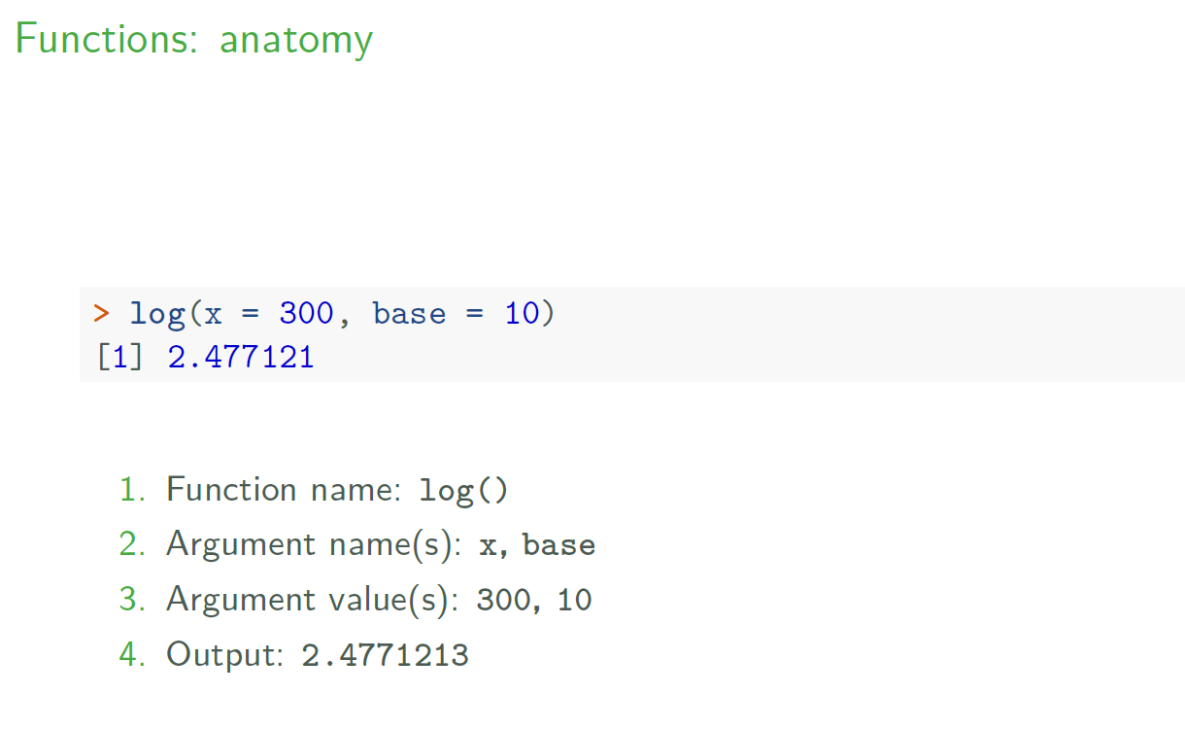

Slide 16
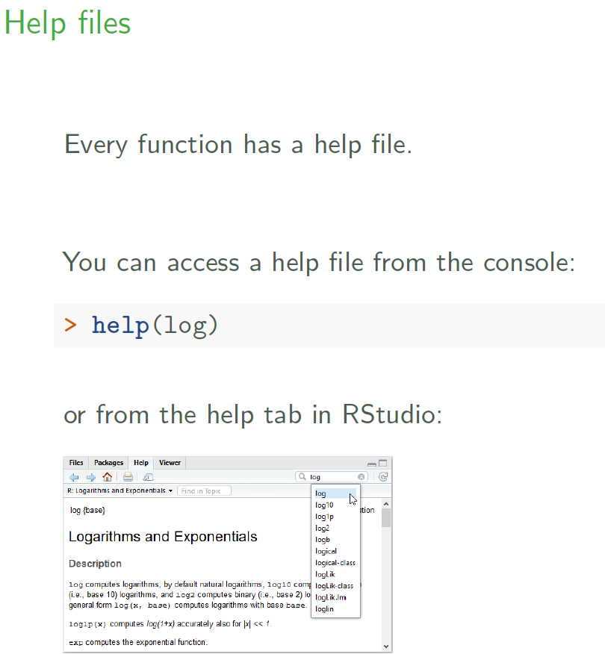

Slide 17
Vectors
Notes:
https://cran.r-project.org/doc/contrib/intro-spatial-rl.pdf

Slide 18
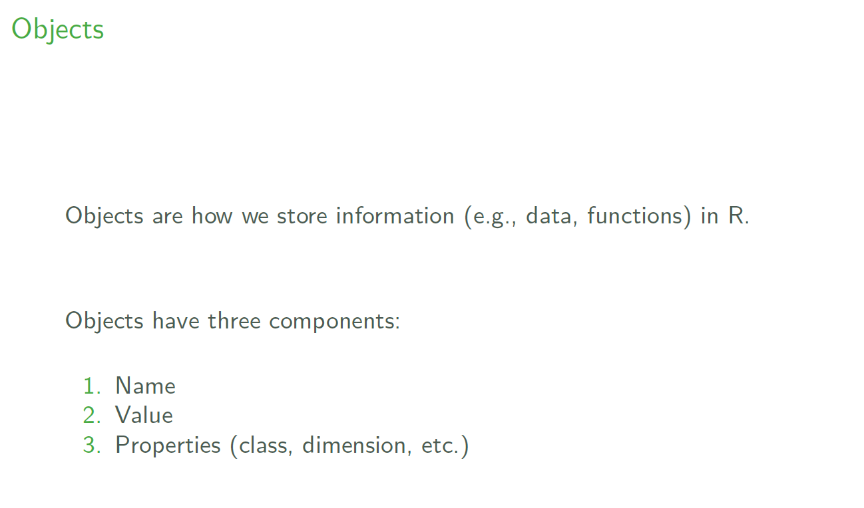

Slide 19
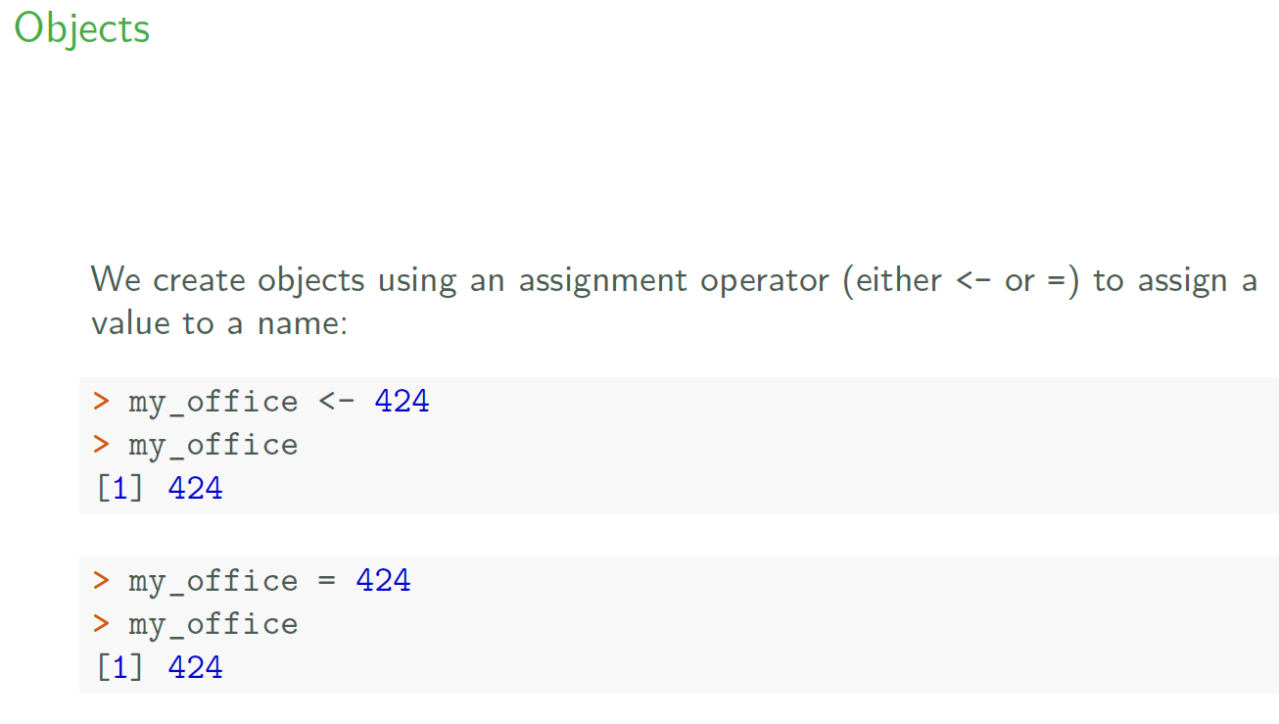

Slide 20
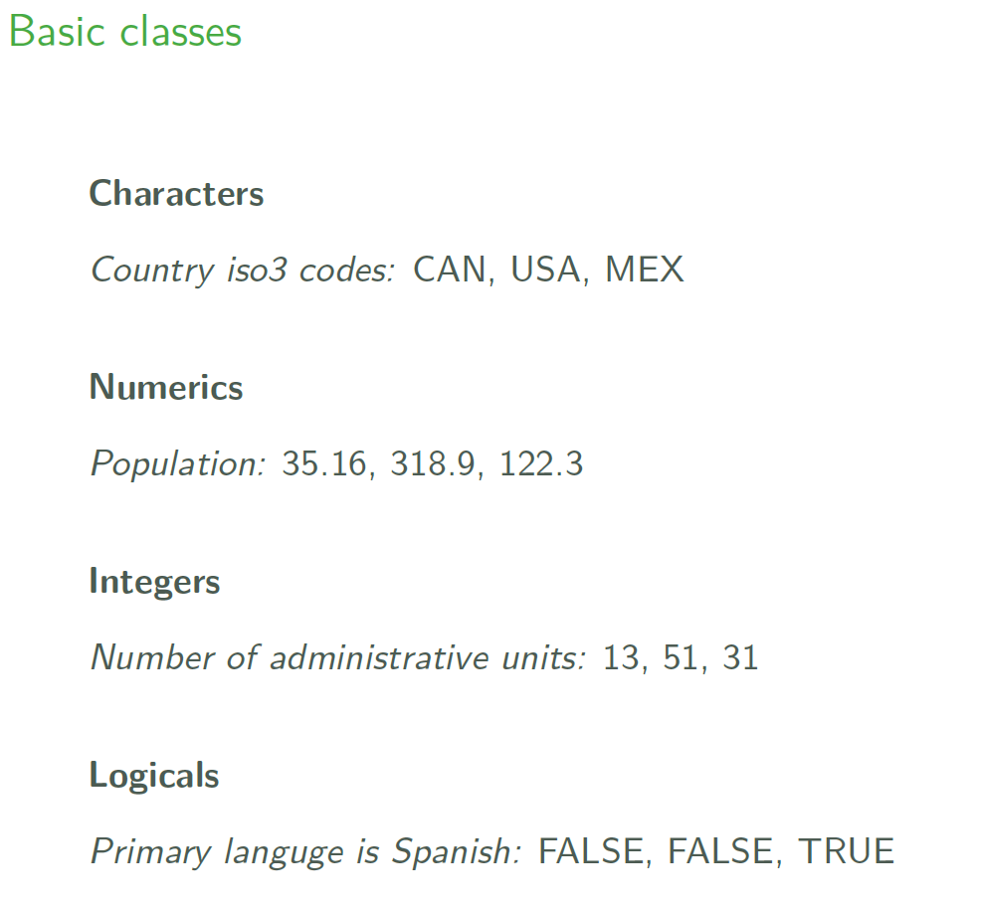

Slide 21
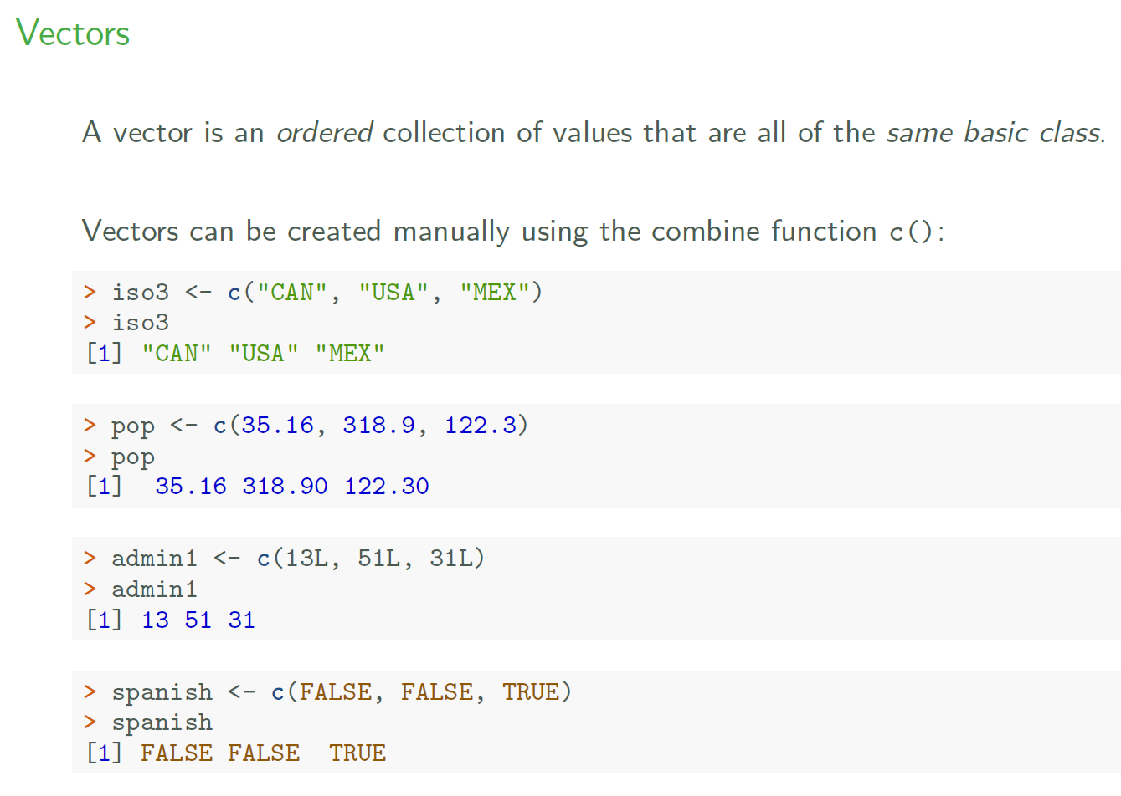

Slide 22
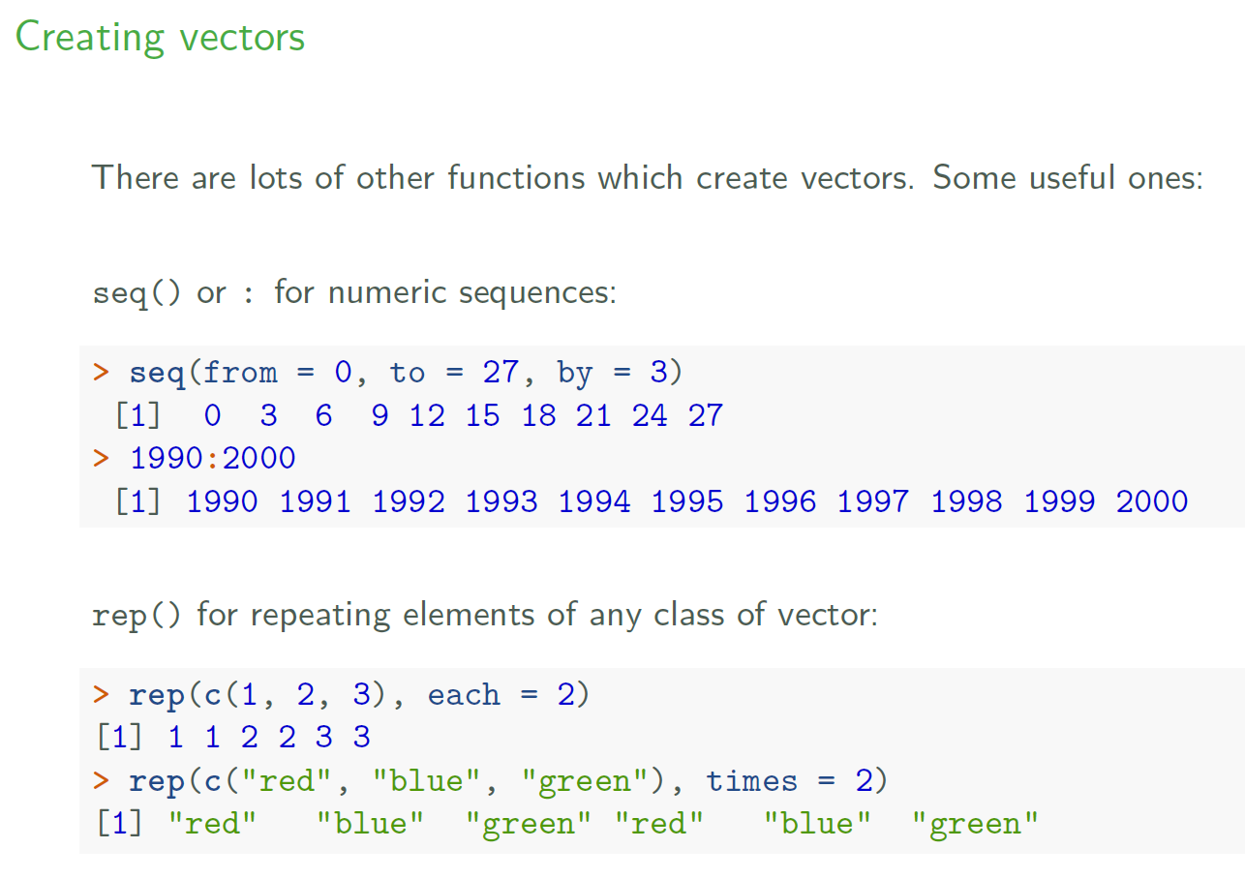

Slide 23
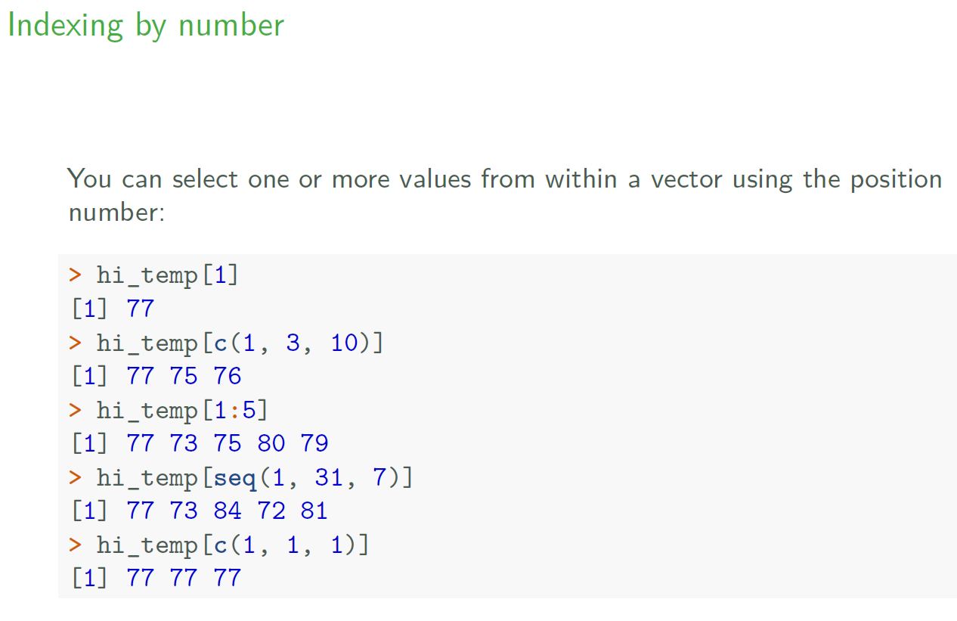

Slide 24
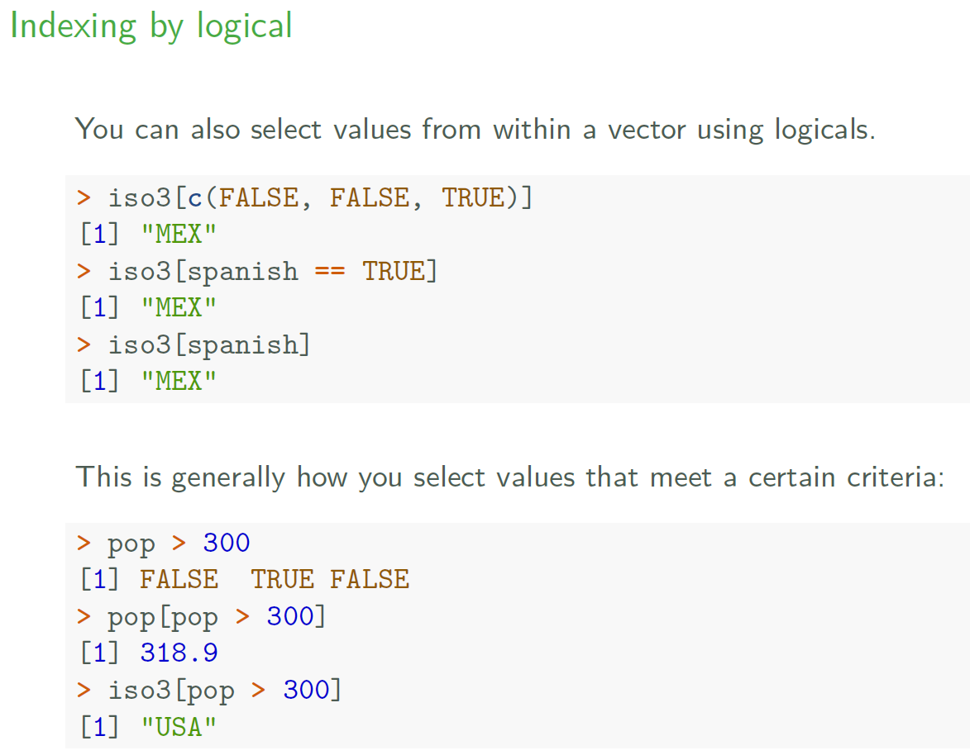

Slide 25
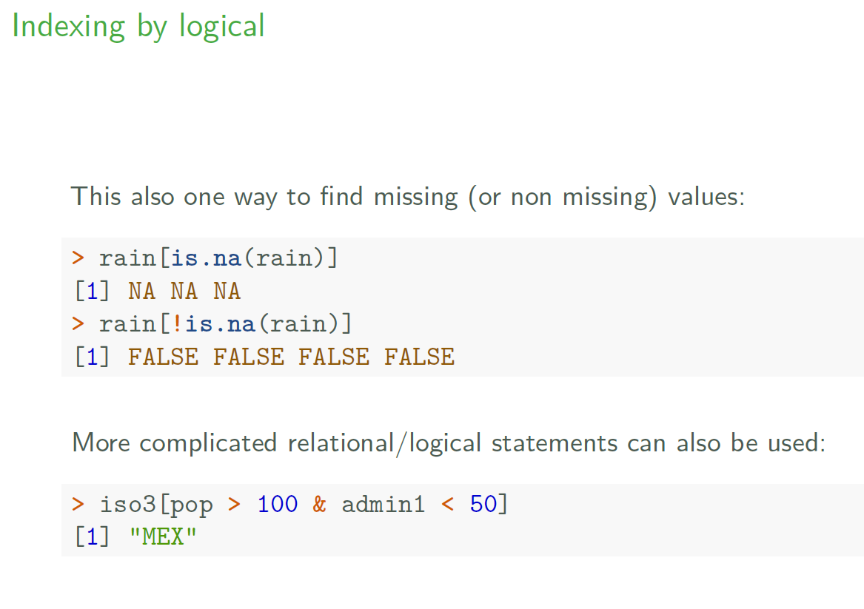

Slide 26
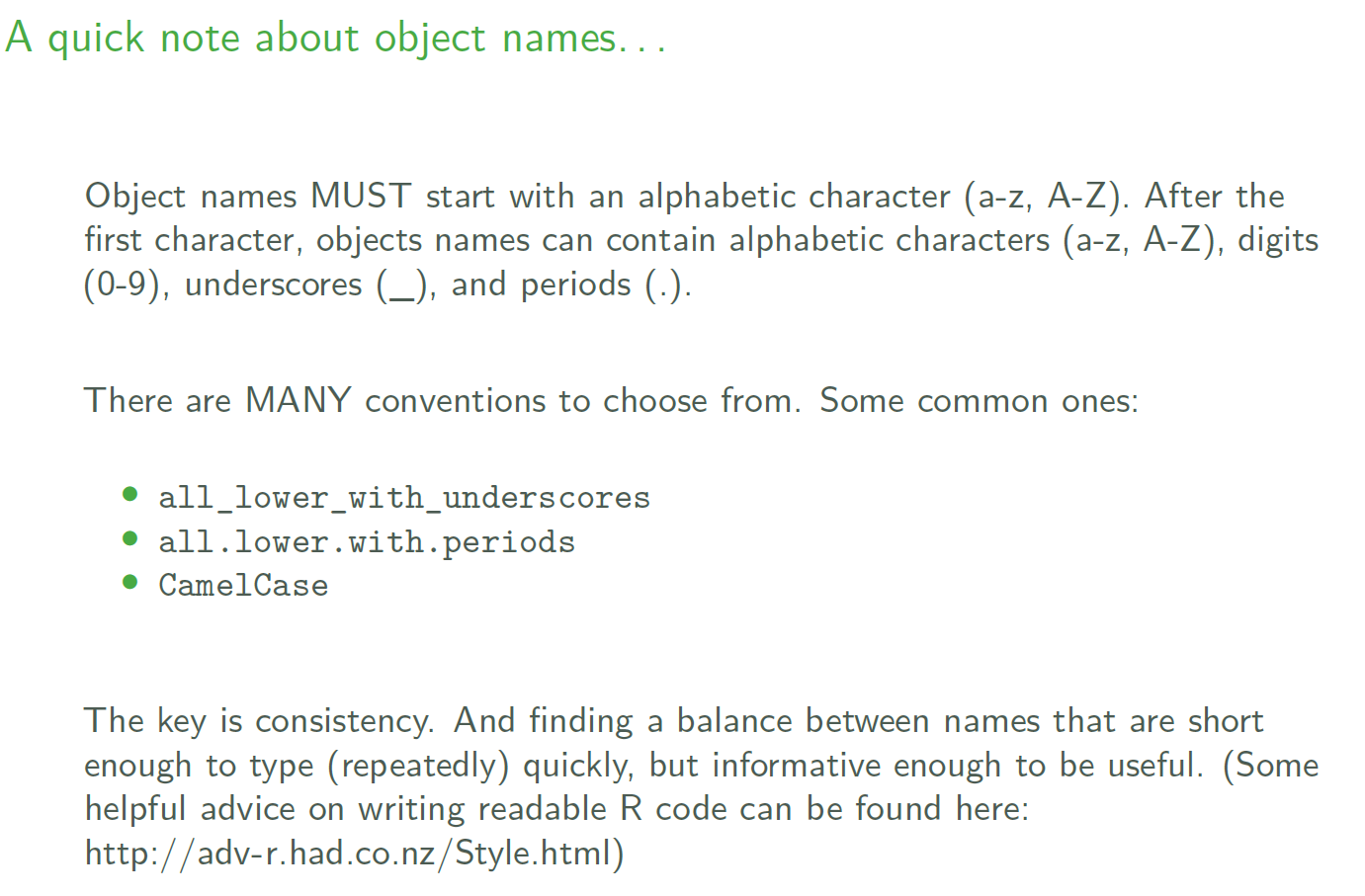

Slide 27
Data frames
Notes:
https://cran.r-project.org/doc/contrib/intro-spatial-rl.pdf

Slide 28
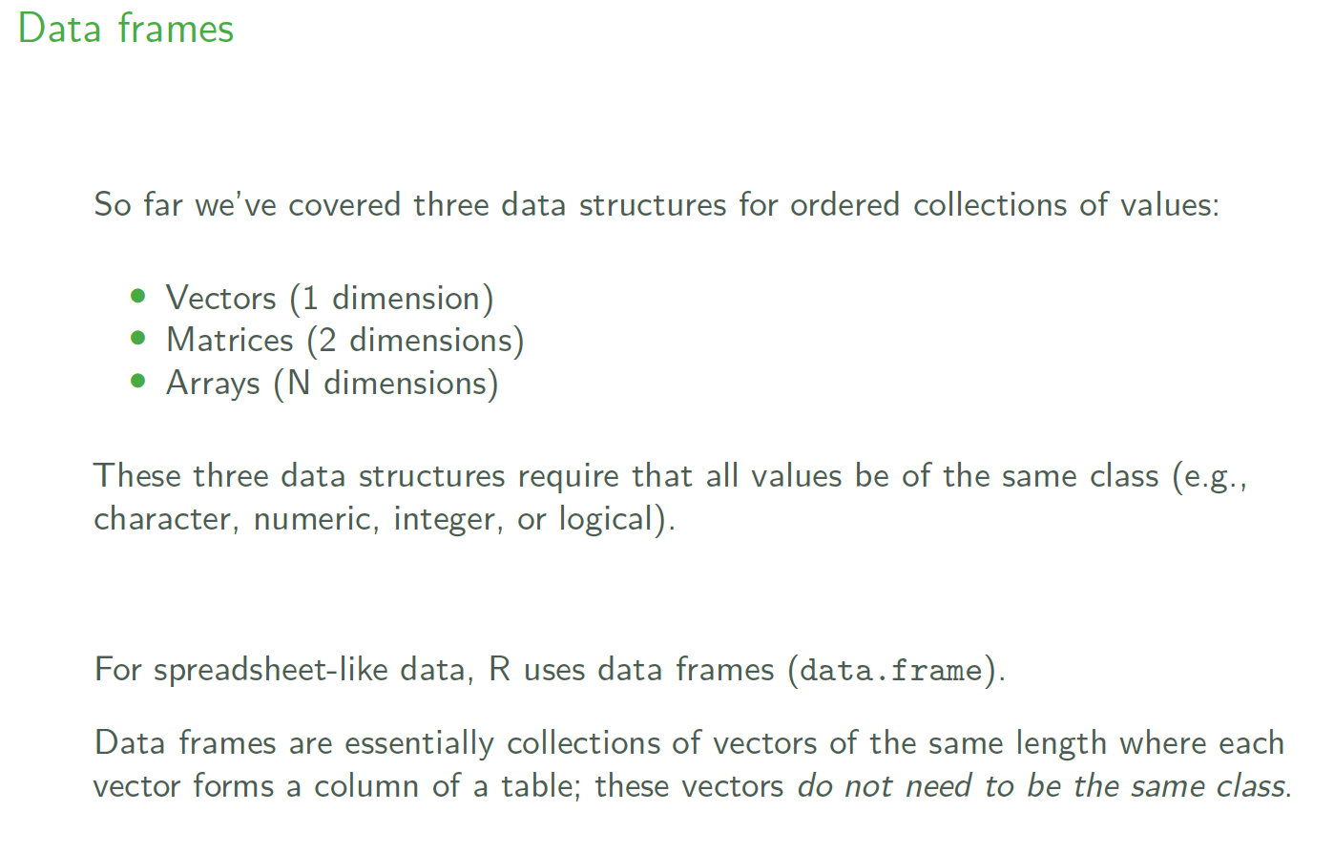

Slide 29
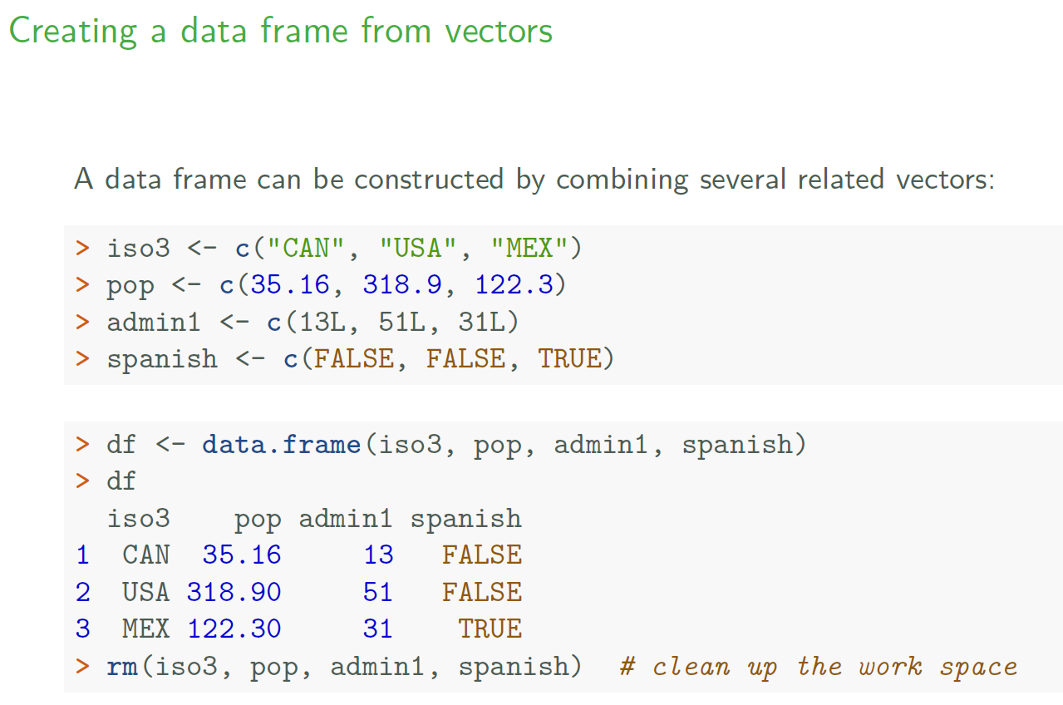

Slide 30
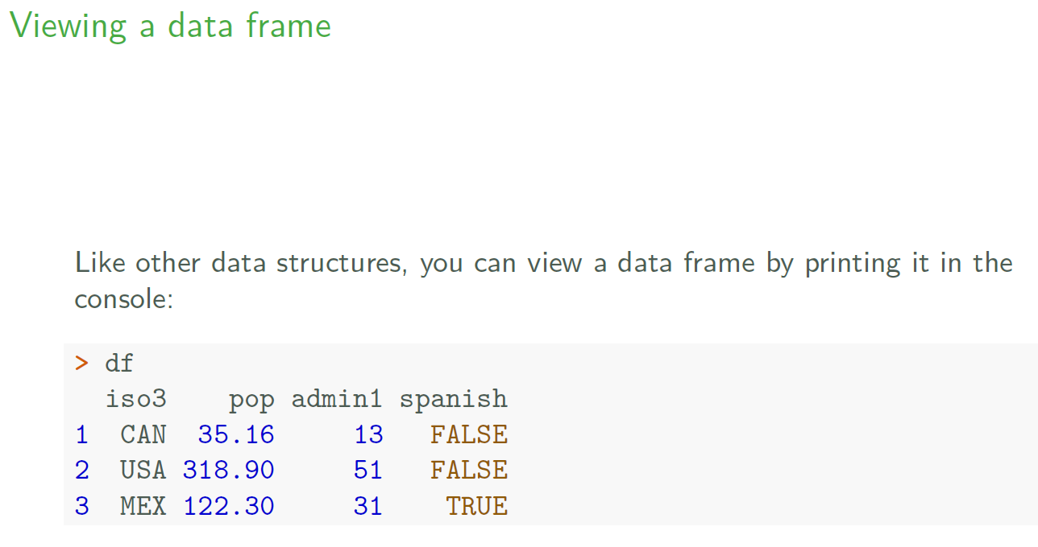

Slide 31
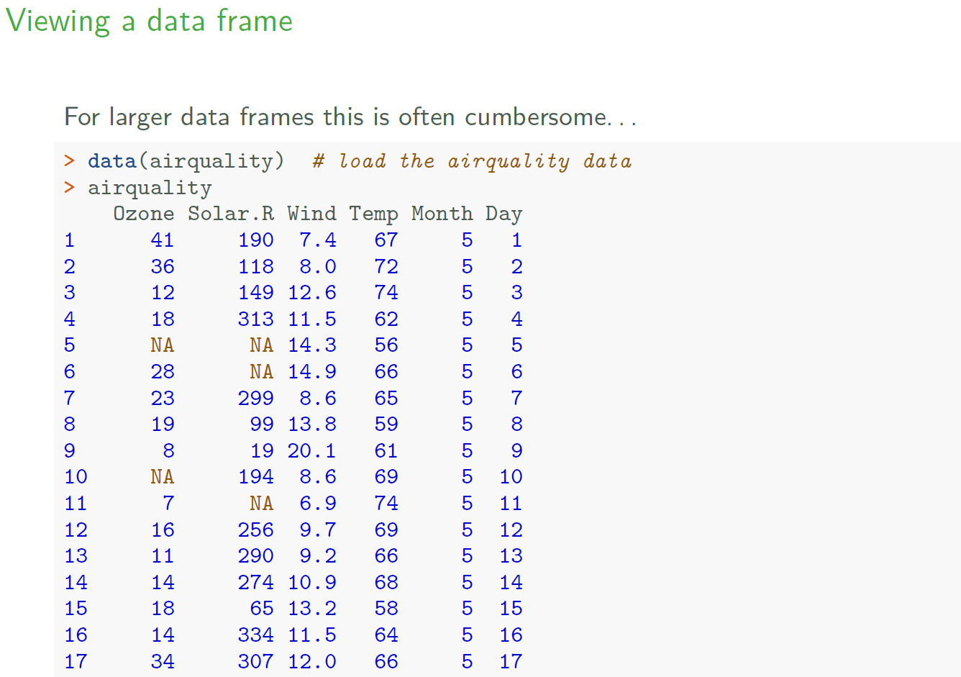

Slide 32
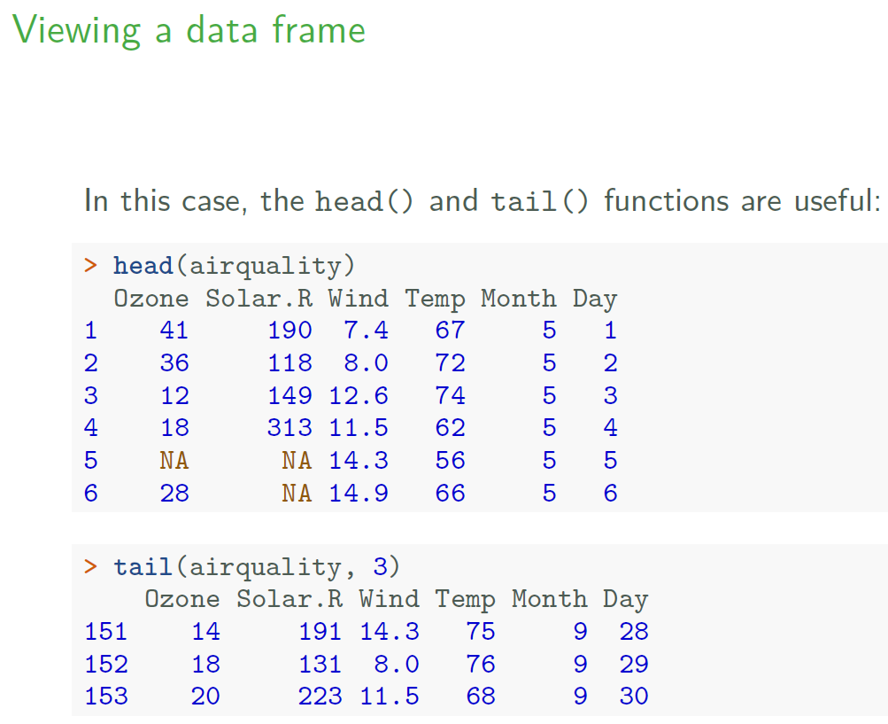

Slide 33
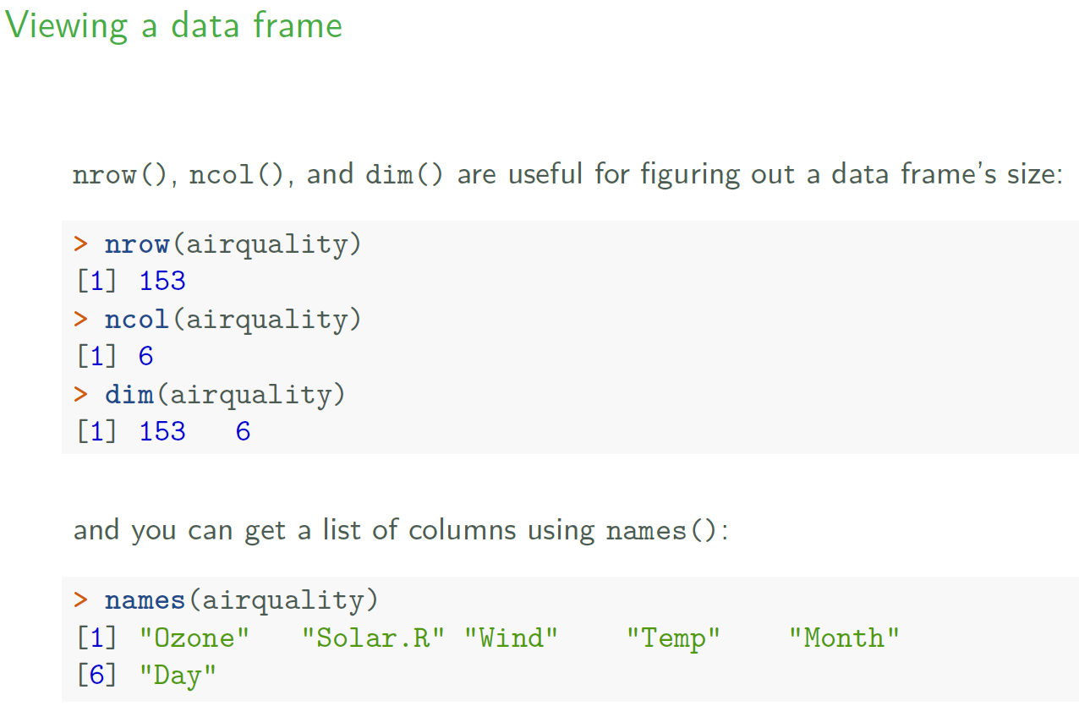

Slide 34
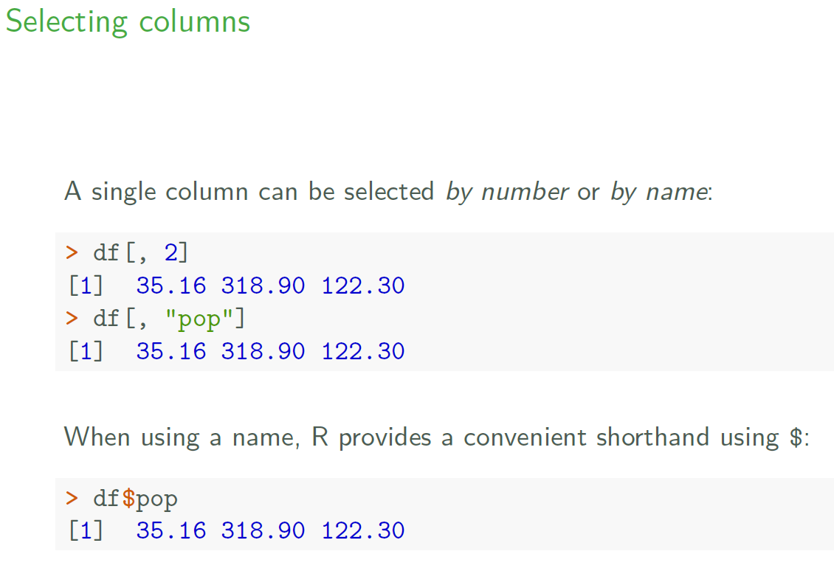

Slide 35
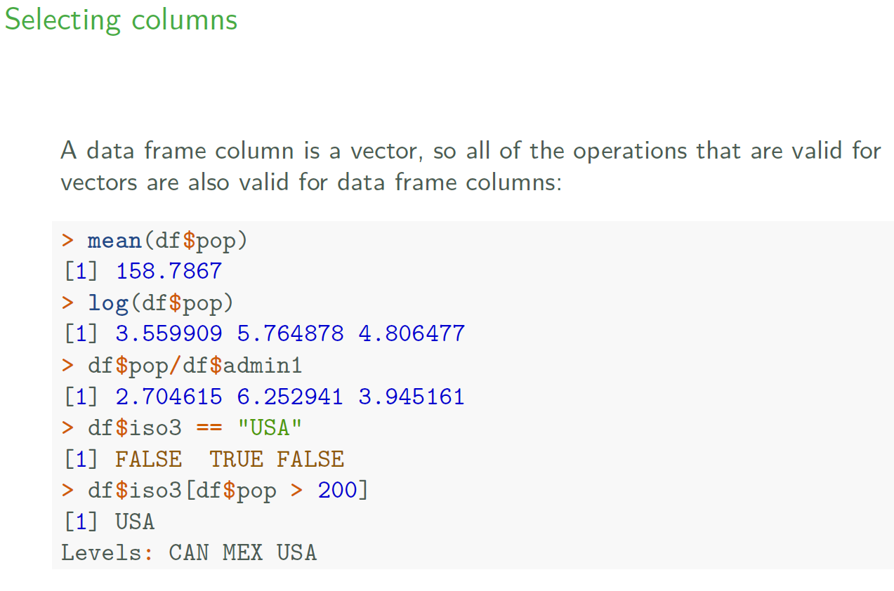

Slide 36
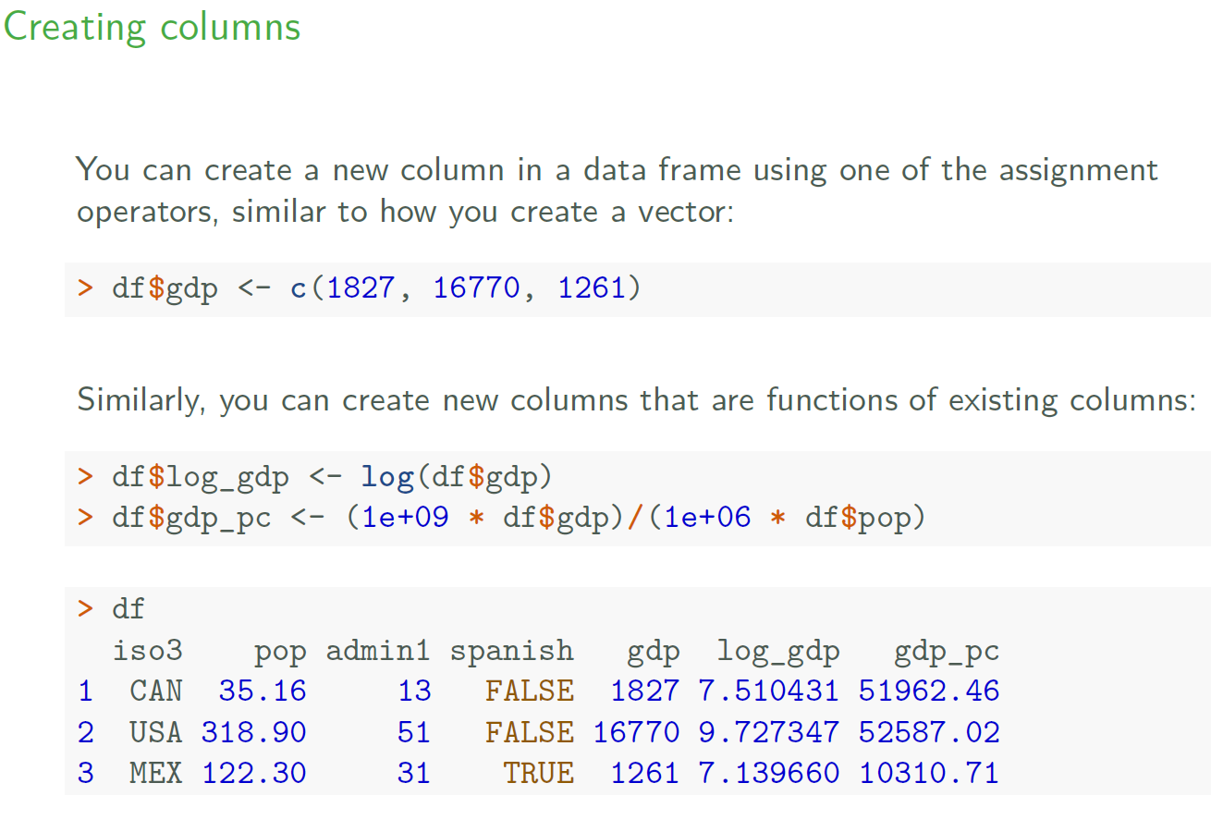

Slide 37
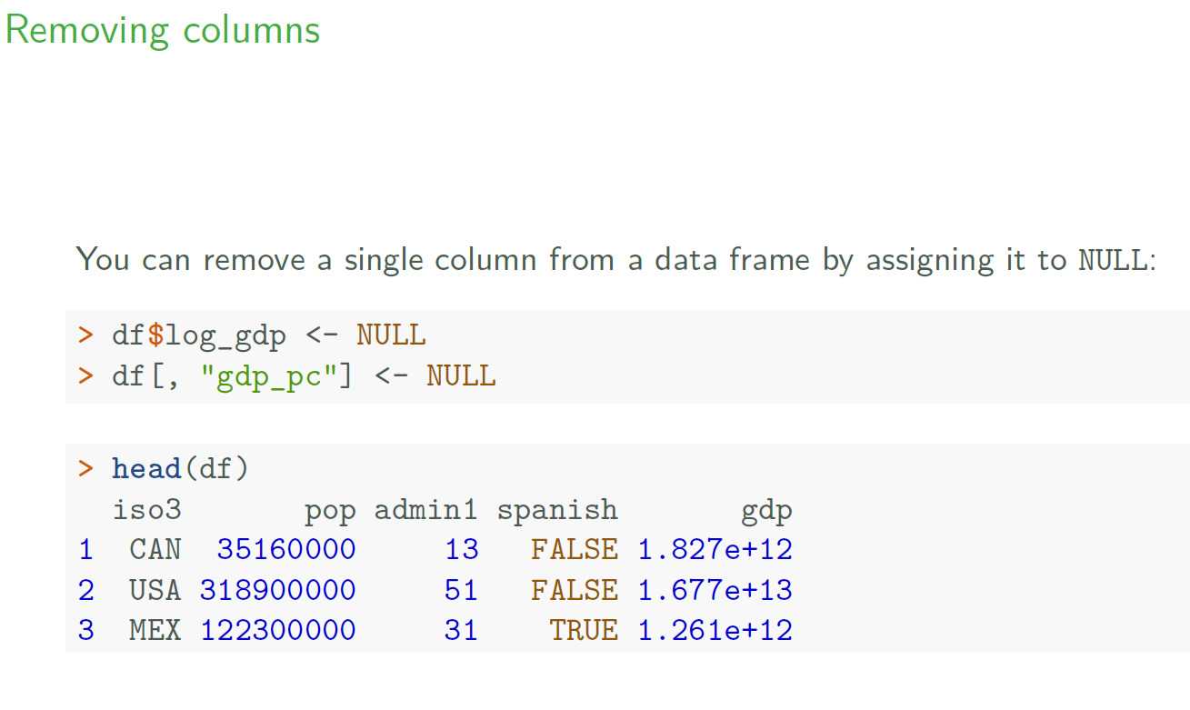

Slide 38
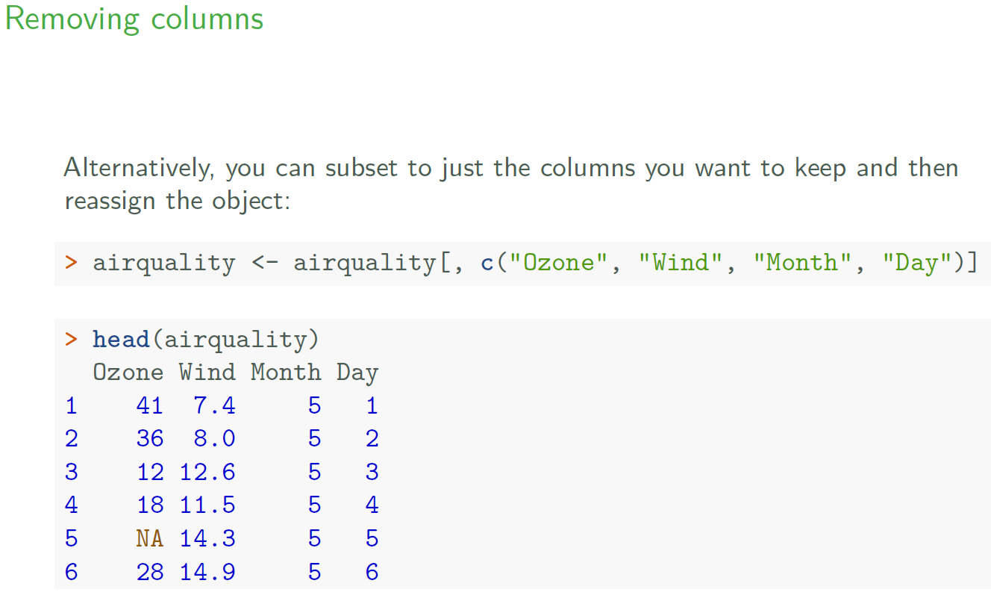

Slide 39
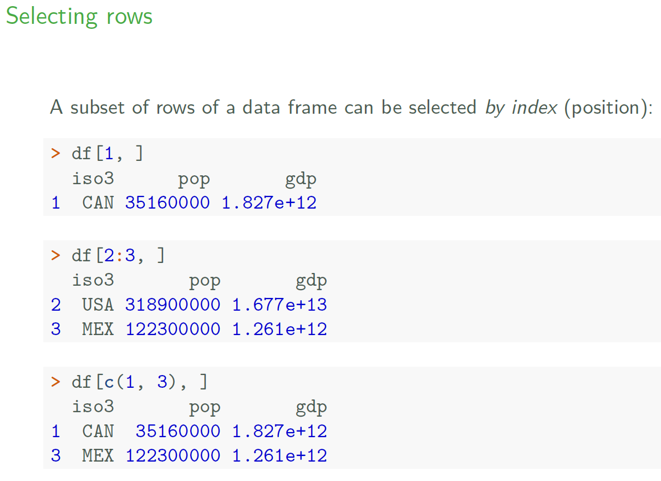

Slide 40
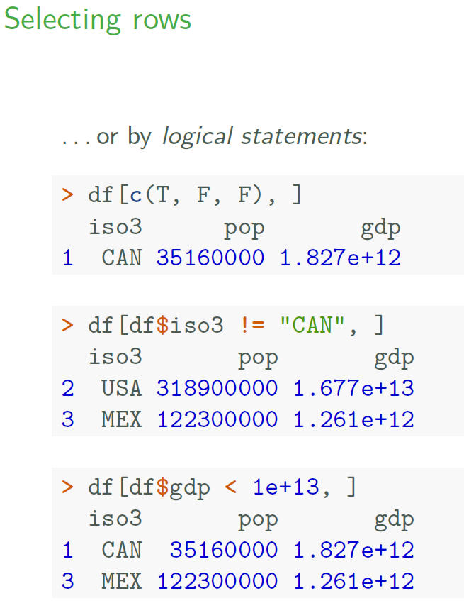

Slide 41
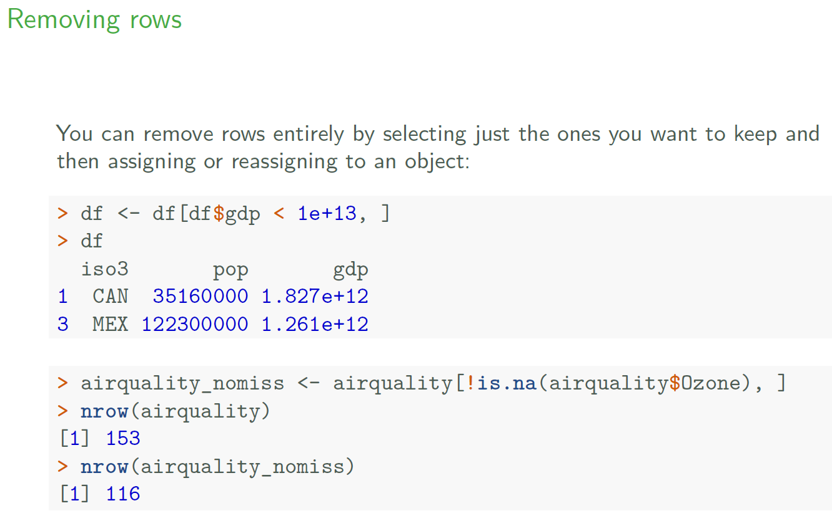

Slide 42
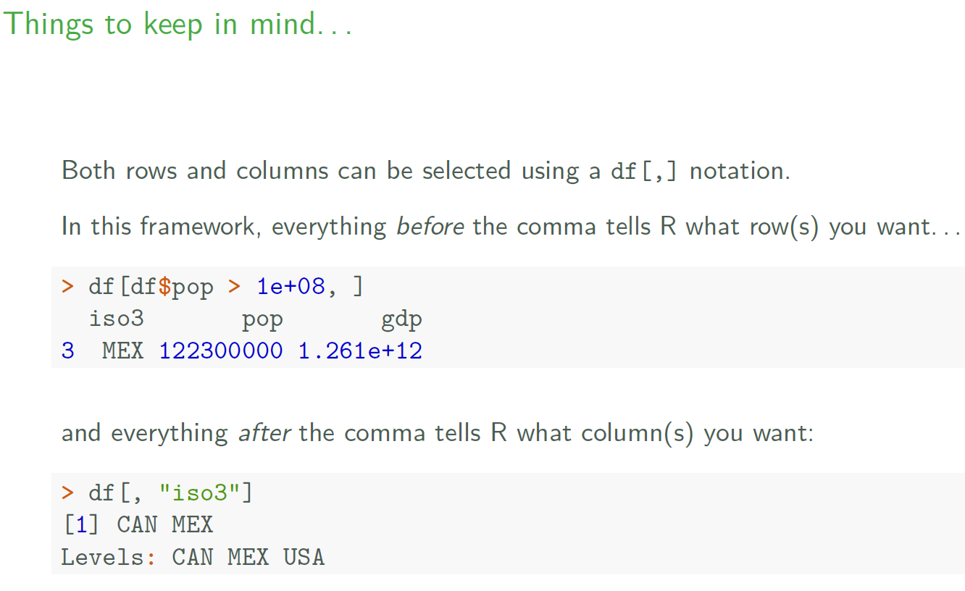

Slide 43
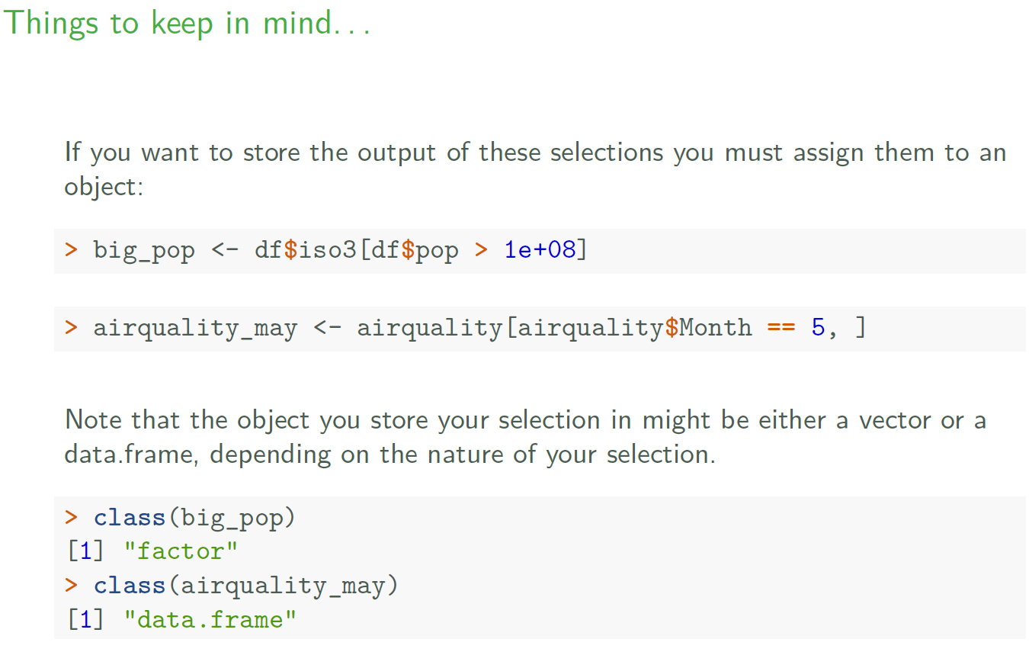

Slide 44
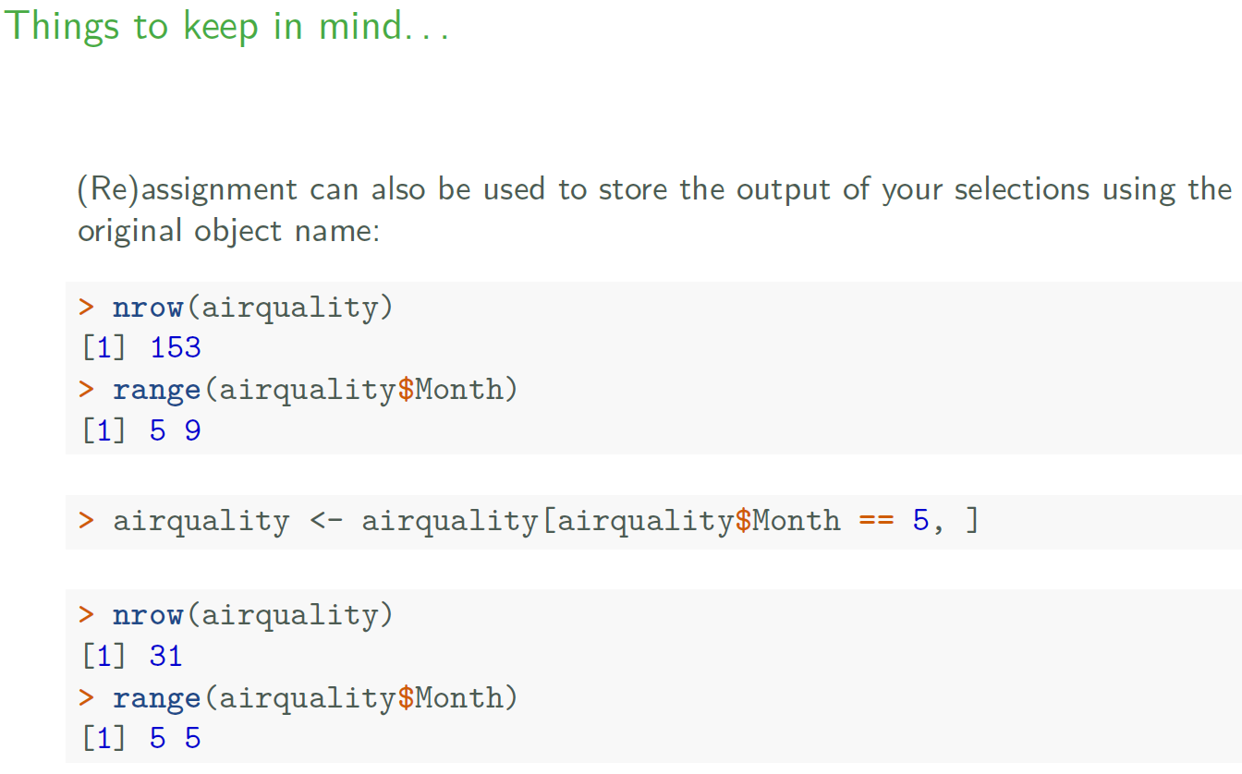

Slide 45
R vs Stata
Notes:
https://cran.r-project.org/doc/contrib/intro-spatial-rl.pdf

Slide 46
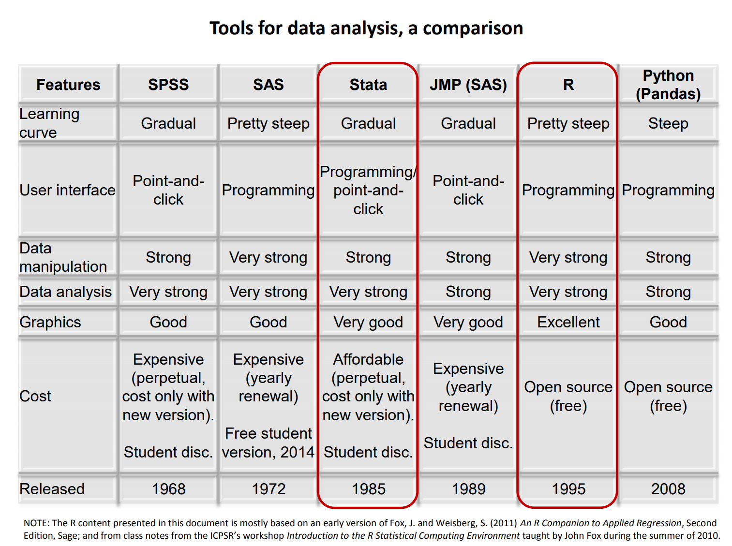

Slide 47
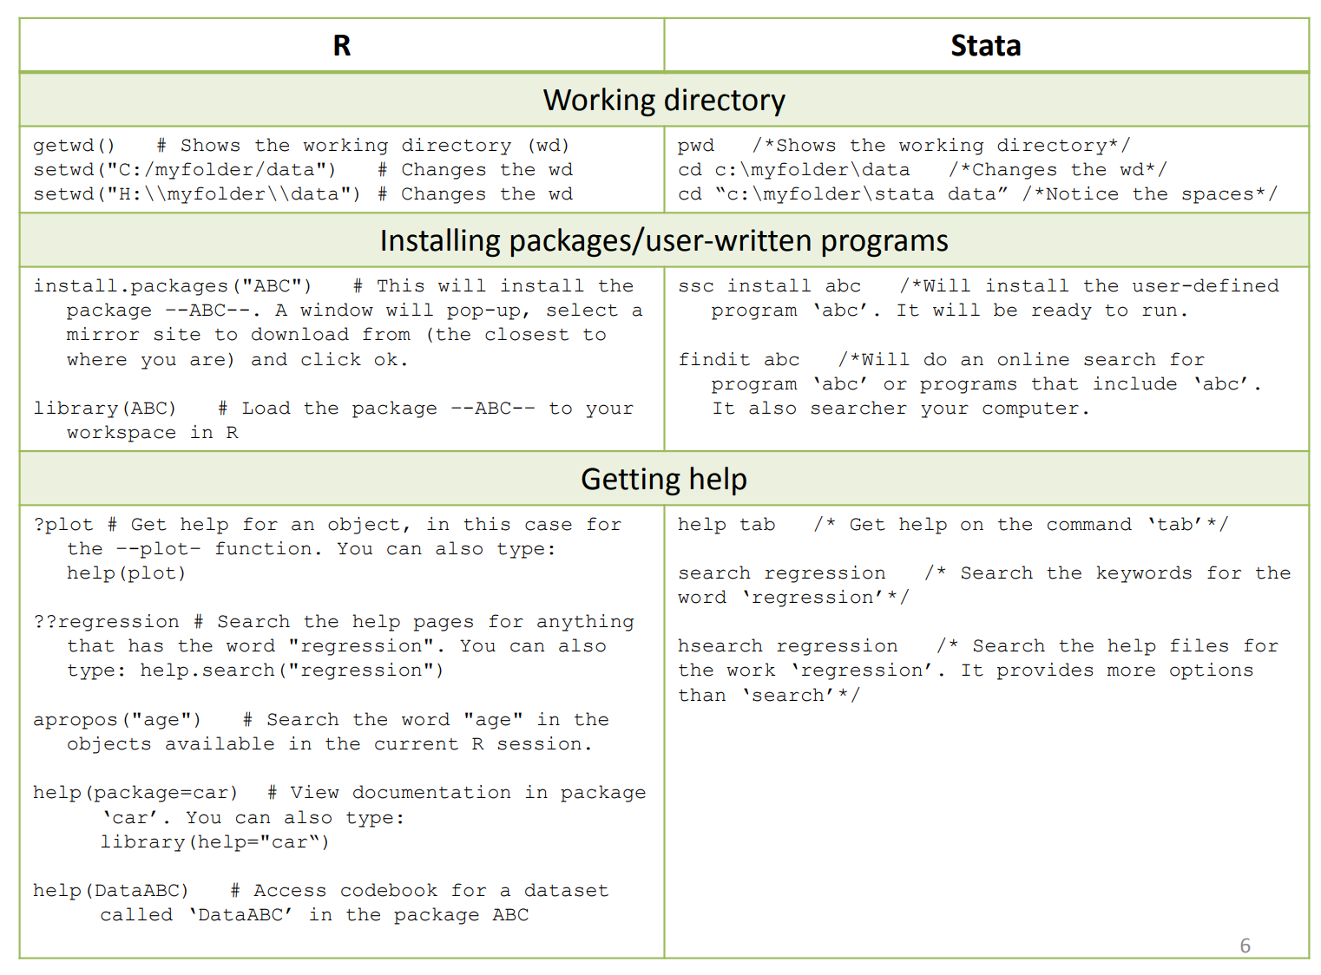

Slide 48
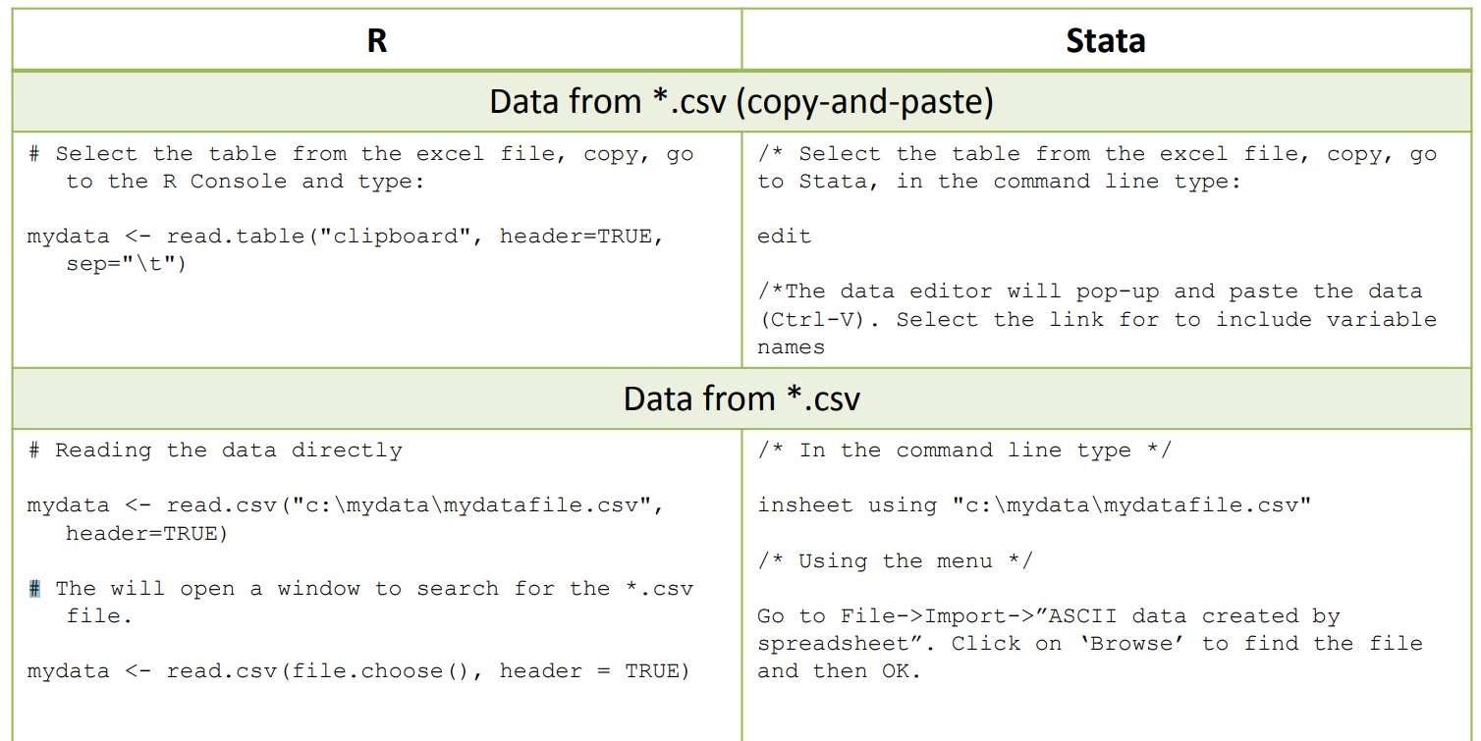
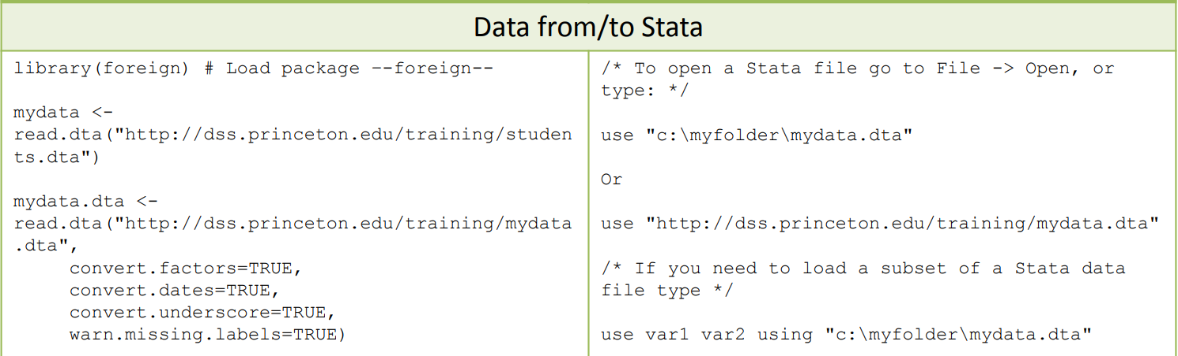

Slide 49
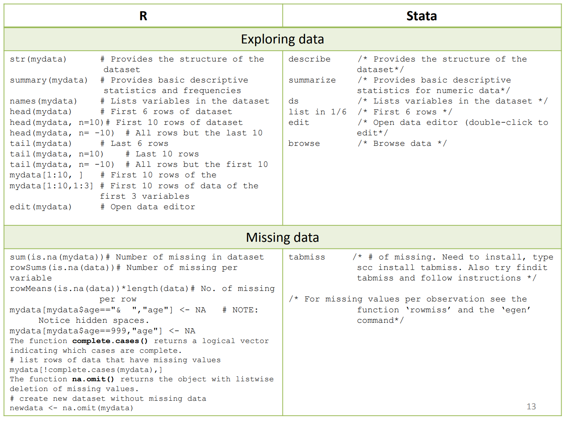

Slide 50
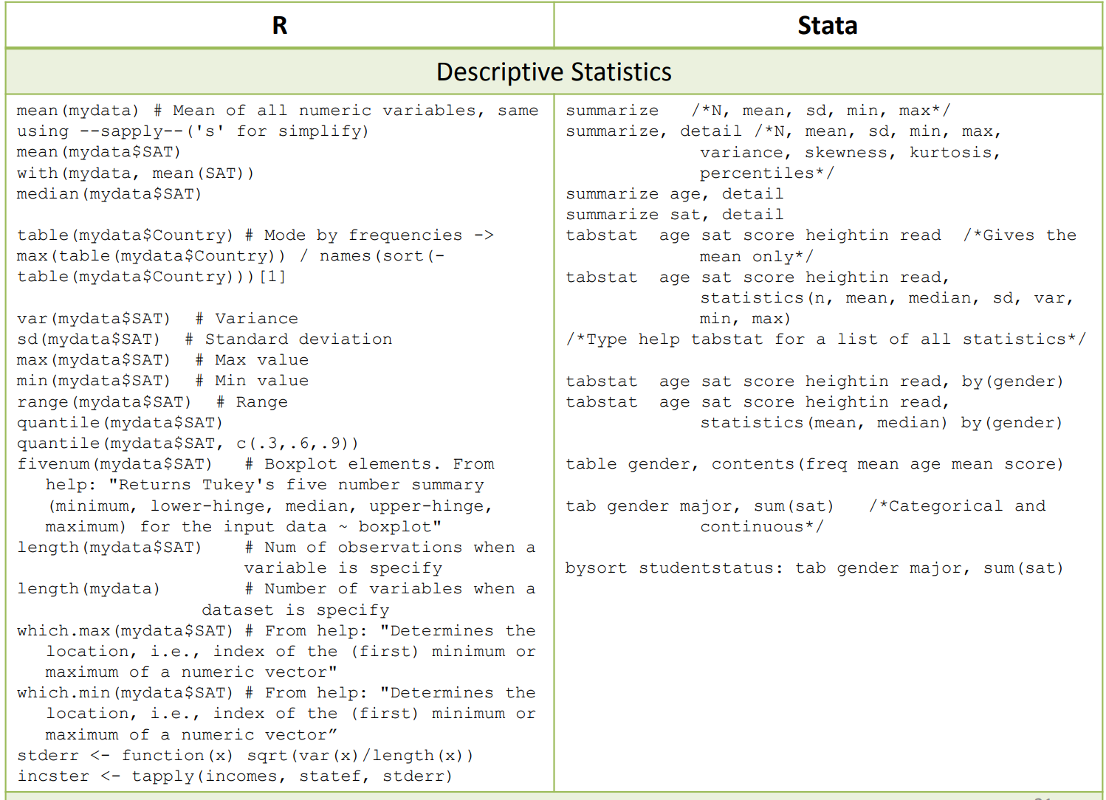

Slide 51
Introducing spatial data in R
Notes:
https://cran.r-project.org/doc/contrib/intro-spatial-rl.pdf

Slide 52
Spatial data packages
Packages we’ll use today:
rgdal: R’s interface to the popular C/C++ spatial data processing library gdal
rgeos: R’s interface to the powerful vector processing library geos
tmap: a new package for rapidly creating beautiful maps
leaflet: simple, fast way to host interactive maps
Others:
ggmap, raster, maptools, and many more!

Slide 53
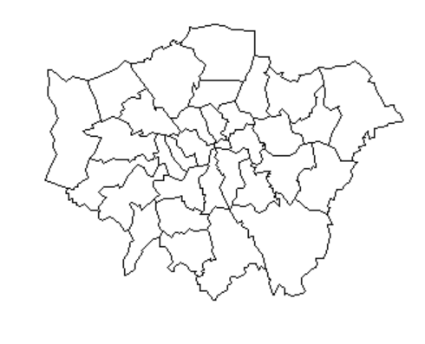
Spatial data in R: shapefiles
Shapefile: a file format for storing information on geographic features like cities, countries, and more. Can be represented by points, lines, or polygons
Made up of a number of different files such as .prj, .dbf, .shp
Many can be downloaded online for free
Greater London area
Notes:
http://desktop.arcgis.com/en/arcmap/10.3/manage-data/shapefiles/what-is-a-shapefile.htm
http://desktop.arcgis.com/en/arcmap/10.3/manage-data/shapefiles/shapefile-file-extensions.htm
https://tapiquen-sig.jimdo.com/english-version/free-downloads/mexico/

Slide 54
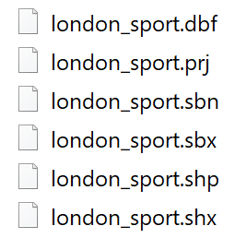
Spatial data in R: shapefiles
Shapefile: a file format for storing information on geographic features like cities, countries, and more. Can be represented by points, lines, or polygons
Made up of a number of different files such as .prj, .dbf, .shp
Many can be downloaded online for free
Main file, stores feature geometry
Notes:
http://desktop.arcgis.com/en/arcmap/10.3/manage-data/shapefiles/what-is-a-shapefile.htm
http://desktop.arcgis.com/en/arcmap/10.3/manage-data/shapefiles/shapefile-file-extensions.htm
https://tapiquen-sig.jimdo.com/english-version/free-downloads/mexico/

Slide 55
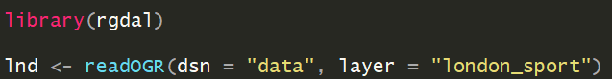
Reading shapefiles into R
readOGR()
dsn – data source name; the folder the file is saved in
layer – the file name (no need to specify the .shp file extension)
Information on the population of London Boroughs in 2001 and the percentage of the population participating in sporting activities

Slide 56
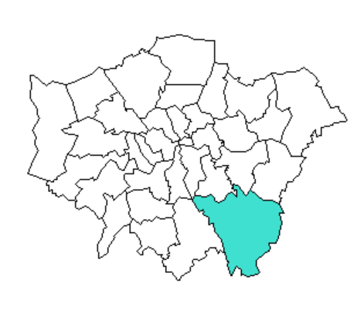
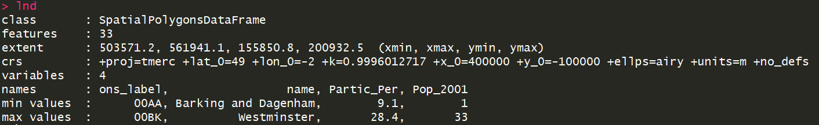
The structure of spatial data
Inputting the object name (lnd) into the console prints a summary
CRS (Coordinate Reference System) says where spatial objects are in the world. Spatial data should always have a CRS.
More on this later
1 feature;
1 row of data
Greater London area

Slide 57
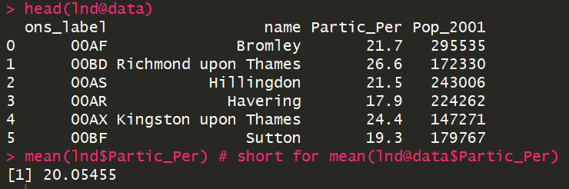
The structure of spatial data
Spatial objects like lnd are made up of a number of different slots:
@data – non-geographic attribute data aka the information we want to graph
@polygons, @lines – make up the physical boundaries
Slots are accessed using the @ symbol
View first few rows

Slide 58
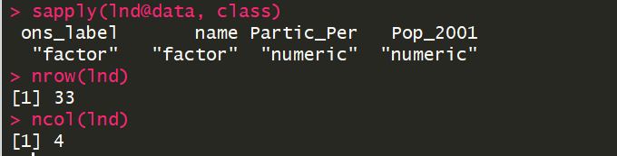
The structure of spatial data
We can explore the @data slot as if it were any other data.frame
What are the data types of the columns?

Slide 59
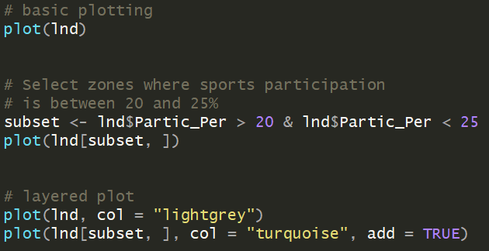
Basic plotting

Slide 60
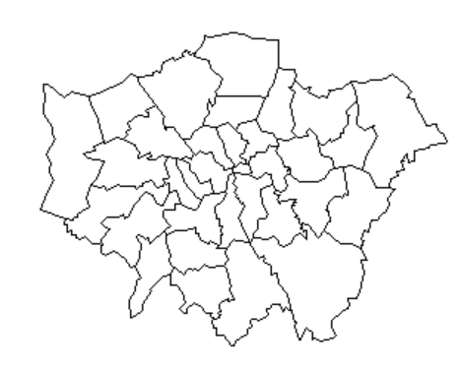
Basic plotting

Slide 61

Basic plotting

Slide 62

Basic plotting

Slide 63

Spatial data: dealing with coordinates
coordinates() – set or retrieve spatial coordinates for a Spatial object. Returns a matrix (similar to a data.frame)
latitude, longitude
Select just latitude

Slide 64


Spatial data: dealing with coordinates

Slide 65


Creating and manipulating spatial data
SpatialPoints() – creates a spatial points object from a data.frame or a matrix
SpatialPointsDataFrame() – creates a spatial points object with an associated data.frame

Slide 66

Creating and manipulating spatial data
SpatialPoints() – creates a spatial points object from a data.frame or a matrix
SpatialPointsDataFrame() – creates a spatial points object with an associated data.frame

Slide 67
Manipulating spatial data
Notes:
https://cran.r-project.org/doc/contrib/intro-spatial-rl.pdf

Slide 68
Coordinate Reference System (CRS)
“A location of (140, 12) is not meaningful if you do know where the origin is and if the x-coordinate is 140 meters, kilometers, or perhaps degrees away”
The most common system is the World Geodesic System 1984 (WGS84), which is essentially a model of the shape of the Earth
The most common CRSs are assigned a EPSG code (European Petroleum Survey Group).
Unique ID that is a simple way to identify a CRS
Notes:
https://rspatial.org/spatial/6-crs.html

Slide 69
Coordinate Reference System (CRS) example
EPSG | CRS
EPSG:27561 | +proj=lcc +lat_1=49.5 +lat_0=49.5 +lon_0=0 +k_0=0.999877341 +x_0=6 +y_0=2 +a=6378249.2 +b=6356515 +towgs84=-168,-60,320,0,0,0,0 +pm=paris +units=m +no_defs

Slide 70

Setting and transforming CRS in R
proj4string() – Set or retrieve the CRS of a spatial object

Slide 71
Setting and transforming CRS in R
proj4string() – Set or retrieve the CRS of a spatial object
27700 represents the British National Grid

Slide 72


Setting and transforming CRS in R
Converting lnd’s CRS to the more widely used WGS84 using spTransform()
Console:

Slide 73


Joining data sets to spatial data
Read in London crime data, filter out all but “Theft and Handling” crimes, and aggregate the total number per borough

Slide 74


Joining data sets to spatial data
Now that our data set is ready, we can join it to our spatial object lnd using left_join()
by specifies what column(s) the two data sets should be joined using. Since the column we want to join on is named differently in the two data.frames, we use this syntax

Slide 75
Joining data sets to spatial data
Now that our data set is ready, we can join it to our spatial object lnd using left_join()
by specifies what column(s) the two data sets should be joined using. Since the column we want to join on is named differently in the two data.frames, we use this syntax

Slide 76


Joining data sets to spatial data: plotting
qtm() – create a quick thematic map
The fill argument allows you to color the map based on a column’s values

Slide 77


Joining data sets to spatial data: plotting
qtm() – create a quick thematic map
The fill argument allows you to color the map based on a column’s values
Many other parameters!

Slide 78
Spatial data in R using ggplot2 and leaflet
Notes:
https://cran.r-project.org/doc/contrib/intro-spatial-rl.pdf

Slide 79

Spatial data in ggplot2
plot() can handle the Spatial objects we’ve been working with; ggplot2 cannot so we have a few extra steps
fortify() – extracts the spatial data into a data.frame
We then need to rejoin our data using left_join() after we create a variable to merge on

Slide 80


Spatial data in ggplot2

Slide 81


Spatial data in ggplot2

Slide 82

Spatial data in leaflet
leaflet is a powerful web mapping system built on a JavaScript library, making it easy to create interactive maps with only a few lines of code
Pairs nicely with shiny, an R package for creating interactive online visualizations
See:
github.com/Leaflet/Leaflet
rstudio.github.io/leaflet/
Notes:
https://leafletjs.com/examples/quick-start/

Slide 83


leaflet: getting started
Notes:
Why do we need to use the lnd84 object? Would the lnd object work as well?

Slide 84


leaftlet

